Slide 1
Formations and Crowds
Keeping formation and simulating crowd movement
Programming – AI for Games
Last modified 09/02/16 by Sam Cartwright

Slide 2
Contents
Flocking Recap
Formations
Crowd Simulation
Force-Based Anticipatory Collision Avoidance

Slide 3
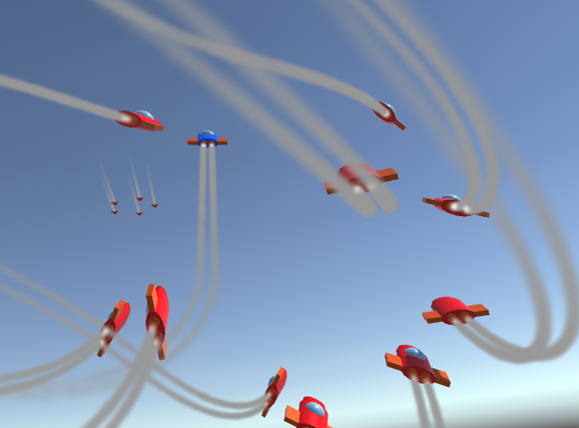
Flocking Recap
3 Forces are calculated:
Coherence
Separation
Alignment
The forces are weighted:
Weighted Truncated Running Sum with Priority.
Distance based scaling.
The forces are combined and applied to the agent.

Slide 4
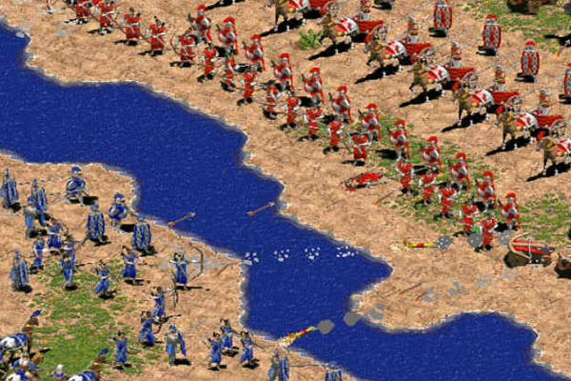
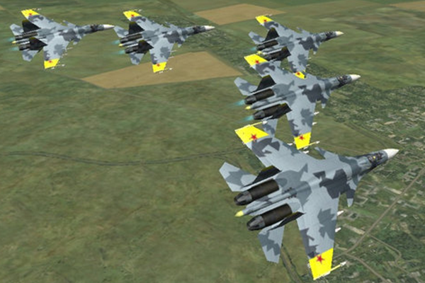
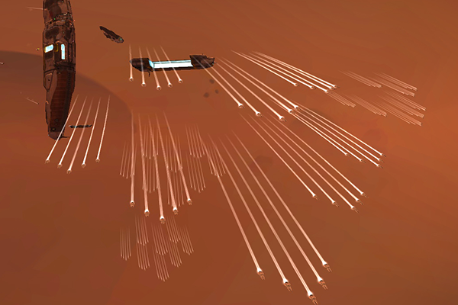
Formations
Formations are another form of A.I. movement similar to flocking.
Common in strategy and air/space combat games.
Age of Empires
Ace Combat
Homeworld

Slide 5
Formations
There are many ways to implement formations.
The exact approach will vary based on your needs.
We’ll take a look at a simple implementation.
Steering behaviours + an offset target from leader.

Slide 6
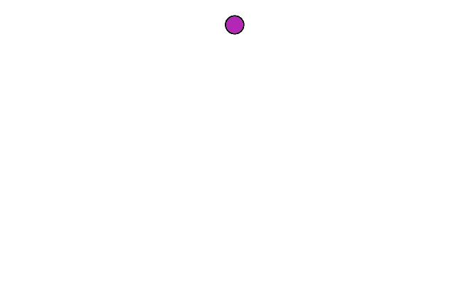
Formations
First assign an agent as the formation leader

Slide 7
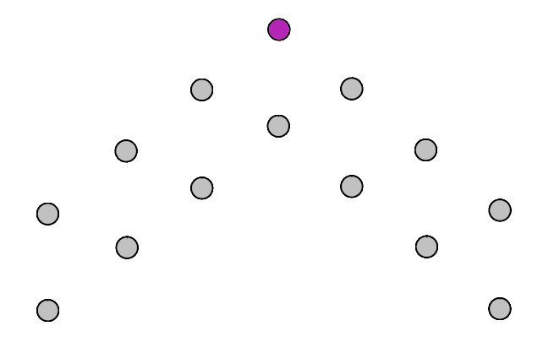
Formations
Then assign other agents to the formation, and give them an offset position from the leader.

Slide 8
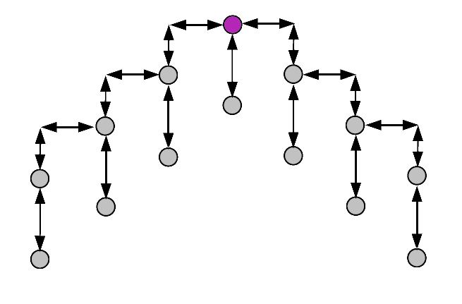
Formations
An agent can now calculate their target position
targetTransform = leader.transform * offset

Slide 9
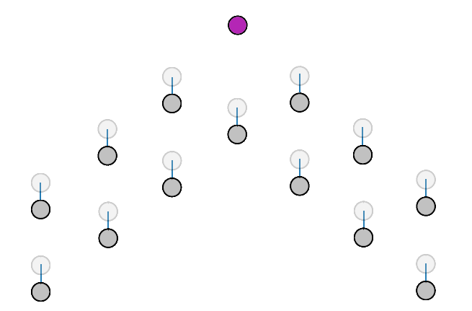
Formations
Agents can then use Seek/Arrive to head towards their designated position within the formation.

Slide 10
Formations
What happens if the leader is removed?
Someone’s gotta do it!
Will agents in a formation collide with each other?
Apply a Separation force or similar.
Should prevent potential gaps in the formation?
See references for a more advanced approach.

Slide 11
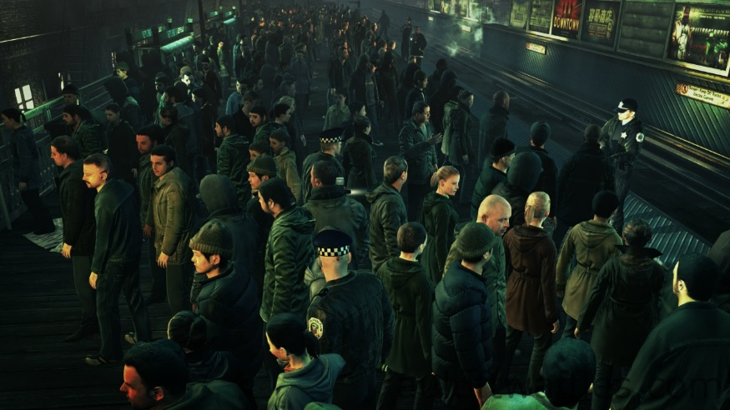
Crowd Simulation
Flocks/Formations:
Groups of agents travelling in unison (birds, fish, soldiers, fighter jets).
Crowds:
Groups of agents travelling independently (pedestrians, shoppers).
Hitman: Absolution
Notes:
- Agents in a flocks stick together and move as a unified swarm.
- Agents in a crowd move independantly whilst avoiding collisions with other agents.

Slide 12
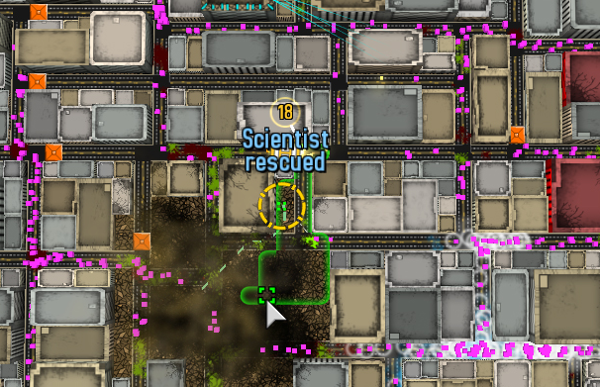
Crowd Simulation
Simple method: wander/seek + separation/evade.
Doesn’t guarentee no collisions.
Only suitable for rudimentary crowd simulations.
Atom Zombie Smasher

Slide 13
Crowd Simulation
There are many ways to tackle crowd simulation.
The exact approach will vary based on your needs.
Much harder than other steering behaviours!
Lets look at a solution developed by Gamma UNC called Force-Based Anticipatory Collision Avoidance.
Be warned, the following is an overview of a very advanced steering behaviour.
See references for detailed resources.

Slide 14
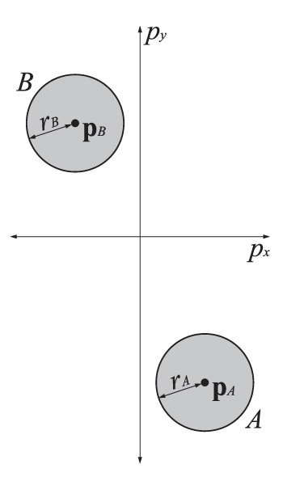
Crowd Simulation
Given two agents, $A$ and $B$ with:
Position $p$
Radius $r$
Velocity $v$
An agent’s current velocity is not needed for the calculation. Our goal is to calculate a range of valid velocities to choose from, not alter an existing one.
Notes:
NOTE: The following slides are tagged with [conceptual] or [technical]. The technical slides do not need to be covered in explicit detail, or fully understood by the students. They exist to demonstrate the complexity of the algorithm and supply a proper explanation for more technically educated students. The exercise/tutorial will cover the actual implementation of the algorithm.

Slide 15
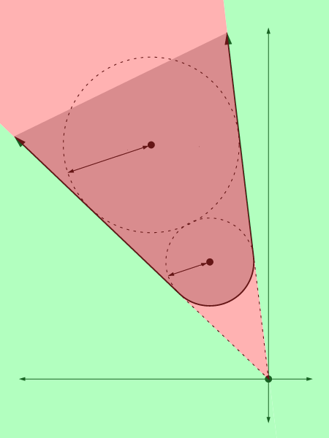
Crowd Simulation
[conceptual]
Find the cone which defines all the possible relative velocities that would result in a collision.
We don’t really need a cone shape, two lines that define an Isosceles triangle will serve our purpose.
This is velocity space, not coordinate space.

Slide 16
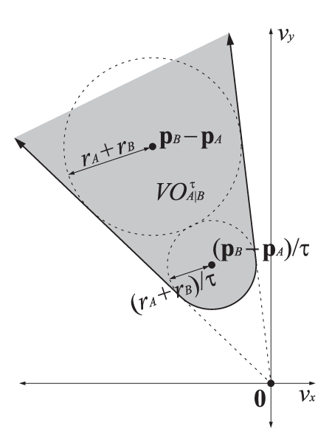
Crowd Simulation
[technical]
Calculate the Velocity Obstacle, ${VO}_{A|B}^{τ}$
The velocity obstacle for $A$ induced by $B$ for time window $τ$ is the set of all relative velocities of $A$ with respect to $B$ that will result in a collision between $A$ and $B$ at some moment before time $τ$
Notes:
THIS SLIDE DOES NOT NEED TO BE COVERED IN EXPLICIT DETAIL (see note on slide 13)

Slide 17
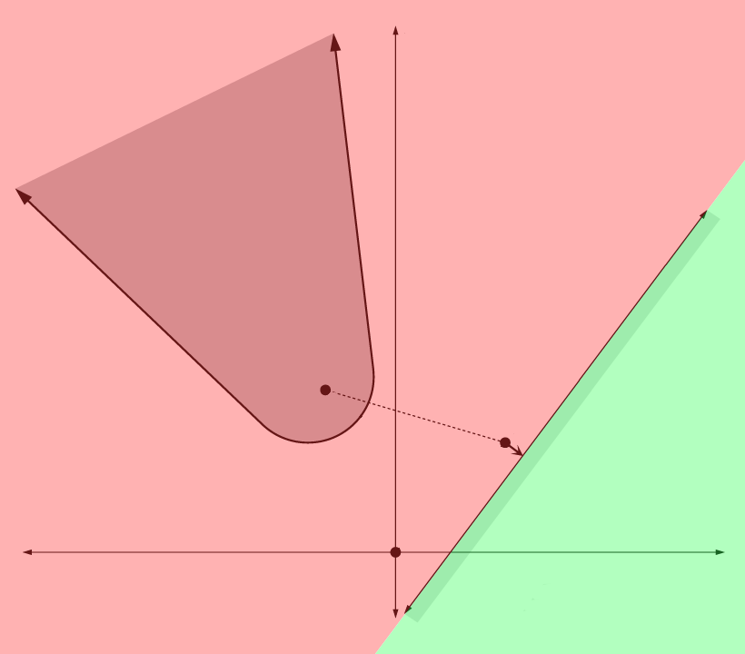
Crowd Simulation
[conceptual]
Using the cone, create a line to mark the divide between collision-free velocities, and those that aren’t.
The line is roughly perpendicular to the cone.
It is a reliable approximation.
(not 100% accurate but still guarantees no collisions).

Slide 18
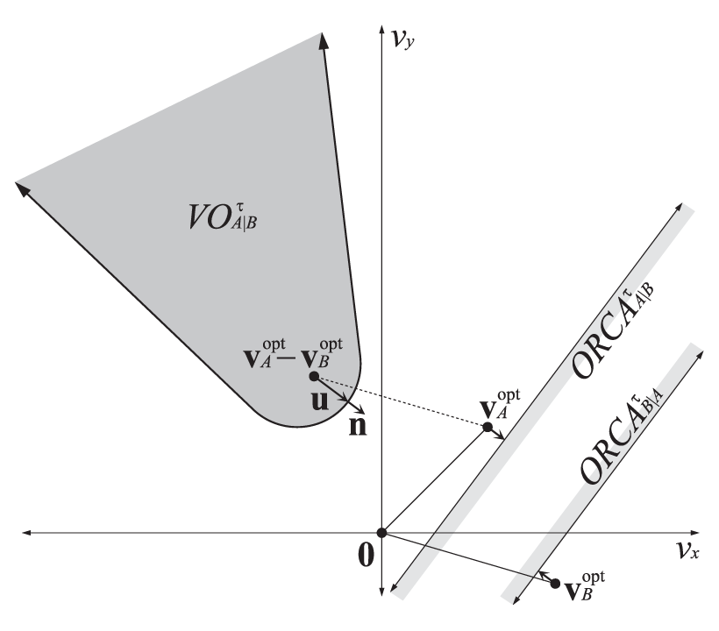
Crowd Simulation
[technical]
Find the Optimal Reciprocal Collision Avoidance set ${ORCA}_{A|\{B…n\}}^{τ}$
The set of permitted velocities for $A$ for optimal reciprocal collision avoidance with $B$ is a half-plane delimited by the line perpendicular to $u$ through the point $v_{A}^{opt}+\frac{1}{2}u$, where $u$ is the vector from $v_{A}^{opt}$ – $v_{B}^{opt}$ to the closest point on the boundary of ${VO}_{A|B}^{τ}$
Notes:
THIS SLIDE DOES NOT NEED TO BE COVERED IN EXPLICIT DETAIL (see note on slide 13)

Slide 19
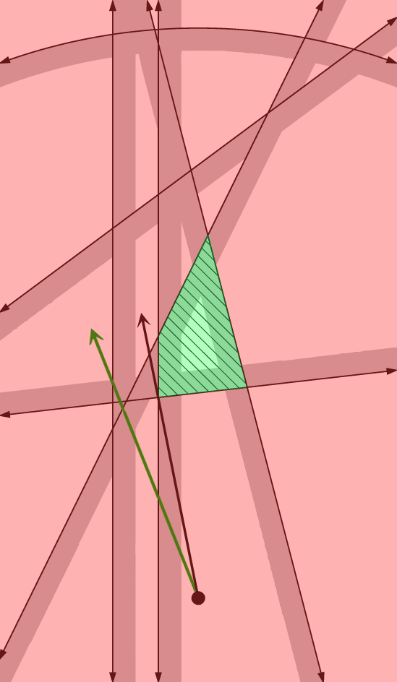
Crowd Simulation
[conceptual]
Repeat this process to find all ORCA lines between a given agent and all other agents.
Find the shape that defines all possible collision-free velocities.
Choose the point within the shape that is closest to our desired velocity and use this as our current velocity.

Slide 20
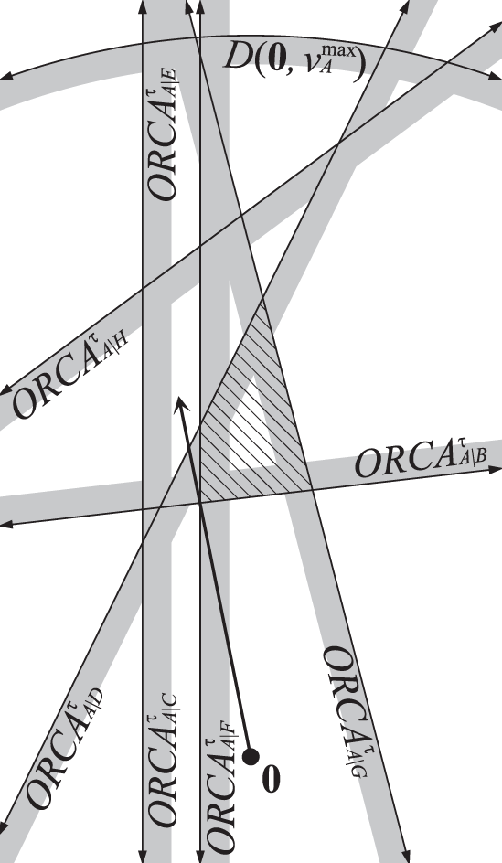
Crowd Simulation
[technical]
Find the point with the closest heading to our desired velocity, as permitted by the ${ORCA}_{A|\{B…n\}}^{τ}$ set and assign to current velocity.
The dashed region is ${ORCA}_{A}^{τ}$ and contains the velocities for $A$ that are permitted with respect to all other agents. The arrow indicates the current velocity of $A$
Notes:
THIS SLIDE DOES NOT NEED TO BE COVERED IN EXPLICIT DETAIL (see note on slide 13)

Slide 21
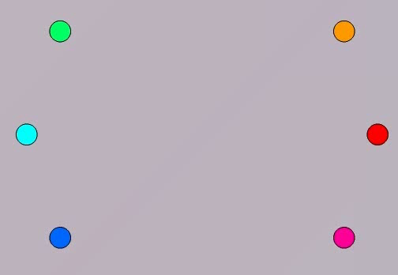
Crowd Simulation
Force-Based Anticipatory Collision Avoidance in action!
http://gamma.cs.unc.edu/ORCA/videos/ORCA-1.wmv

Slide 22
Crowd Simulation
Fortunately Gamma UNC have created a publicly available code library which implements this technique, titled RVO2 Library
It’s free to use for non-commercial purposes.
It’s written in C++ and C#.
It’s a great way to develop an understanding of how this technique really works when implemented.
See references for link.

Slide 23
Summary
Formations are a great way to create believable (often militaristic) movement and positional patterns.
Crowd simulation allows large groups of agents to act independently with realistic and predictive movement behaviour.
And can be a very complex, academic subject.

Slide 24
References
Formation Techniques:
Millington, I. and Funge, J. (2009). Artificial intelligence for games. Burlington, MA: Morgan Kaufmann/Elsevier, pp.144 -166.
Crowd Simulation:
Guy, S., Snape, J., Lin, M. and Manocha, D. (2015). Optimal Reciprocal Collision Avoidance (ORCA). [online] Gamma.cs.unc.edu. Available at: http://gamma.cs.unc.edu/ORCA/
Gamma.cs.unc.edu, (2015). RVO2 - Reciprocal Collision Avoidance for Real-Time Multi-Agent Simulation. [online] Available at: http://gamma.cs.unc.edu/RVO2/

